Slide 1
Cancer Biology Biol 445
Spring 2020
Dr. Heidi Super
Lecture 32
5-1-2020

Slide 2
Announcements
Quiz 5 – Grading now.
Final exam---May 11th –10 am – 11:50 am.
(misprint in syllabus)
We will discuss format for the exam—There will not be a 6th quiz, separate from the final exam. There may be some new material included in the exam.

Slide 3
Where were we?
Treating cancer---The old and the new!
Some chemotherapy drugs have been used for decades. Most are hard hitting cytotoxic agents that damage cells so severely that they are induced to die by apoptosis.
New approaches tap into the host’s immune system and some target specific cancer-associated gene alterations.

Slide 4
New drugs must be tested in clinical trials
Long-term
Multiple discipline teams
Patient participants!
Physicians
Medical support—tests/imaging/health management
Data collection
Analysis

Slide 5
Careful regulation
Information---many professionals involved in explaining purpose, methods, expected outcomes, risks.
Informed consent
Institutional review for human subjects
IRB approval

Slide 6
It is essential to have evidence that the new drug/procedure is actually better than the current best practice, in some way.
Clinical trials must procure funding.
Government ( NIH/NCI)
Pharmaceutical companies
Advocate organization
Non-profit organizations
*In the US, the Affordable Care Act mandates that insurance companies pay for normal patient care while under a clinical trial.

Slide 7
Phase 0/I
Safety of the drug/procedure
Research on safe doses—highest dose with no serious side effects
Dose timing and delivery
Observations of side effects
Testing for changes in effect of other drugs you may be taking. Some monitoring of efficacy
Small number of volunteers (phase 0)…then more (20-80). Several months-1year

Slide 8
Phase II (~70% of phase I move on)
Continued monitoring of safety
Focus on Efficacy
Fine-tuning of dosage
Comparison to standard treatment(s) of the day

Slide 9
Phase III (~30% move on from phase II)
True comparison of new drug/procedure to standard treatments. Must be as safe and effective as standard treatment to move forward with the drug.
Requires careful controls—randomization of patients receiving the drug and those receiving the standard
Thousands of participants if possible—more rare side effects show up.

Slide 10
Most Phase III trials are double-blind, meaning the participants and the clinicians and researchers don’t know which participants are receiving the new and standard drugs
No one should have expectations or bias in phase III.

Slide 11
Phase II and III groups/arms
Participants may receive several types of treatments---so there can be several arms to a Phase III trial.
Experimental arm---getting new drug
Active comparison arm—getting old drug
Placebo comparison arm—getting inert/inactive compound—no drug activity
Sham/mock comparison arm---getting similar overall care/drug but contains no active form of experimental drug
No intervention arm

Slide 12
Phase IV—post approval (25-30% of phase III—those that receive approval for general use of the new drug/procedure)
Continued monitoring/comparison of the new drug.
Gain info on long-term safety and effectiveness
Begin to note resistance, if it occurs
May note off–target benefits of a drug

Slide 13
With increased education and control over one’s own treatment, more people know about and seek out clinical trials.
https://clinicaltrials.gov/ct2/home

Slide 14
In the US, final approval for a new drug comes from the Food and Drug Administration. It is usually a years-long process to make sure a drug is safe and worth using.
When there is an emergency situation, some of the criteria of clinical trials is relaxed and the FDA may approve a new drug or medical device/protocol quicker.

Slide 15
Emergency Use Authorization (EUA)
https://www.fda.gov/emergency-preparedness-and-response/mcm-legal-regulatory-and-policy-framework/emergency-use-authorization
*Look closely at the Covid-19-associated EUAs

Slide 16
Gleevec!
One of the all time fastest drugs to go from to bench to bedside.
~2.5 years after the compound was synthesized and chemically shown to bind to the BCR-ABL fusion protein. (Applied for its use as a drug)
Approved after 3 phase II trials showed nearly 90% cure rate for CML in 2.5 months. Placebo arm particiapnts were placed immediately into the experimental drug arm!

Slide 17
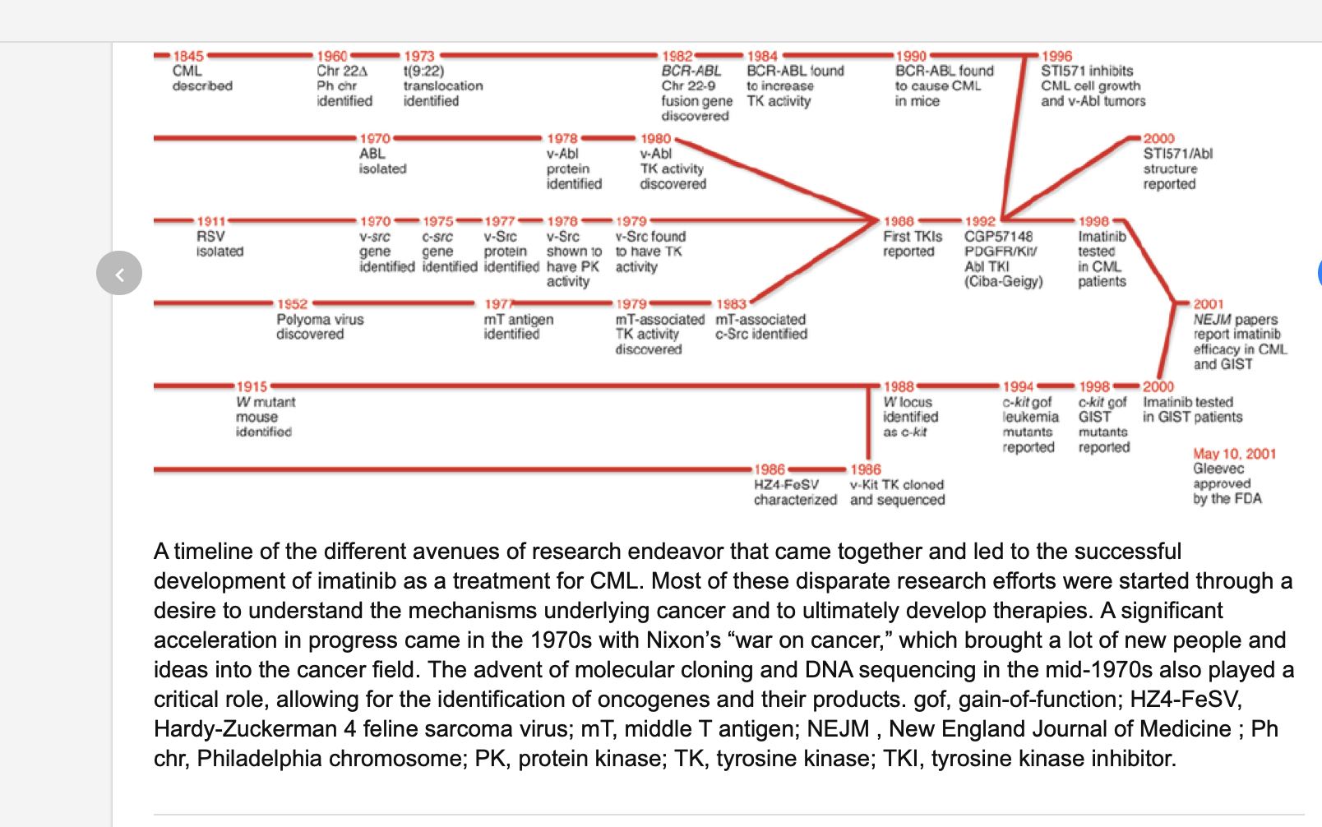
Gleevec was over 40 years in the making

Slide 18
Brian Druker designed the actual small molecule, STI571. The rationale was that it had to bind to the kinase domain of the BCR-ABL fusion protein.
The drug is also called Imantinib and Gleevec
Several drugs have been developed since, based on the same rationale

Slide 19
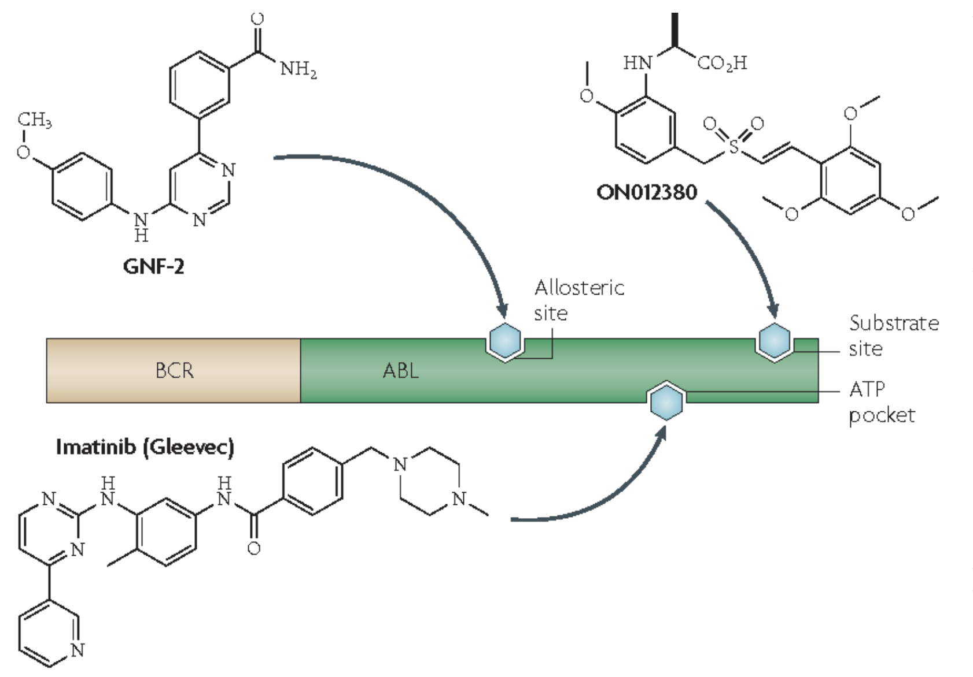

Slide 20
Other Rationally designed drugs.
We’ve already discussed several drugs designed to target specific cells---by binding to cell-type specific molecules.
Herceptin *
Immune checkpoint inhibitors*
CAR-T-cells
AVASTIN—binds the VEGF—a endothelial cell growth factor to inhibit angiogenesis*
*monoclonal antibodies

Slide 21
Besides antibodies, another class of drugs called “small molecule inhibitors” (SMI) have become a successful approach to treating cancer and other diseases.
In principle, for cancer and inhibitor implies that the drug will be decreasing the activity of something---most often, oncogenes/oncoproteins. (Gleevec—for example)

Slide 22
SMI cancer drugs---4 main approaches.
1. Many SMI drugs target cell proliferation pathways---of which you have studied several.
Since a major mechanism for signaling a cell to divide involves phosphorylation of proteins, many of the SMI drug design approaches have been attempts to inhibit kinases

Slide 23
With regard to cell proliferation , SMI drugs work to inhibit different signaling pathways
1. Through growth factors which activate:
RAS---called the RAS-MAPK pathway
PI3K-ATK pathway
2. Through cytokines that activate JAK---the JAK-STAT pathway
3. Through the family of EGFreceptors

Slide 25
Why ”small”? These drugs must enter cells and interact with other molecules.
https://www.oatext.com/pdf/ICST-1-109.pdf
Good article—summarizing/reviewing some smi-drugs.

Slide 26
Your textbook (chapter 11) ends with some mention of theory behind gene therapy approaches for cancer.
Ideas for altering defective genes or inhibiting the expression of oncogenes.

Slide 27
A few approaches
Using antisense RNA or RNA interference to keep oncogenes from producing oncoproteins.
Using gene targeting methods for changing mutations in DNA.

Slide 28
Targeting mRNA
Antisense RNA are molecules of RNA complementary to the coding mRNA transcribed from a gene.
When antisense RNAs bind to mRNA, the mRNA cannot be translated.

Slide 29
RNA interference (RNAi)
RNA interference is a normal cellular response for destroying invading RNA (most of the time from pathogenic viruses). It uses the invading RNA to make an antisense version---then when bound to the invading RNA, it causes the destruction of the invading RNA.
Researchers can design RNAi molecules to target virtually any RNA molecule they want destroyed. i.e. oncogene mRNA.

Slide 30
CRISPR-Cas 9 technology
Your textbook came out before CRISPR was discovered and applied to genetic research, but some gene therapy approaches hope to deliver normal versions of genes to cells in the hopes of restoring normal cell division.
CRISPR cannot only introduce mutations, it can replace nucleotides with other—change the DNA of a cell.

Slide 31
Application?
Restoring/fixing loss of function of tumor suppressor genes.
*Gene therapy has always had the challenge of delivery. How do you get the gene/gene alteration to the cells you wish to affect.
Really hard to target or maintain the delivery to somatic cell.

Slide 32
Stem cells
One approach is to alter cells serve as stem cells for tissues.
Most work has been done in hematopoietic stem cells. Replace bone marrow with altered stem cells. The alteration will be in every type of blood cell, indefinitely.

